Slide 1
Chi Huynh SSH
VPP Coordinator
Valero Benicia Refinery
chi.huynh@Valero.com
707-742-0683
THE “HUMAN ELEMENT”
Notes:
Introductions.
What are we going to get out of this today?
The Rorchach Test. Developed in the early 20th century.

Slide 3
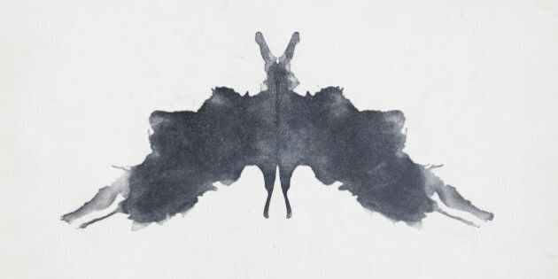

Slide 4
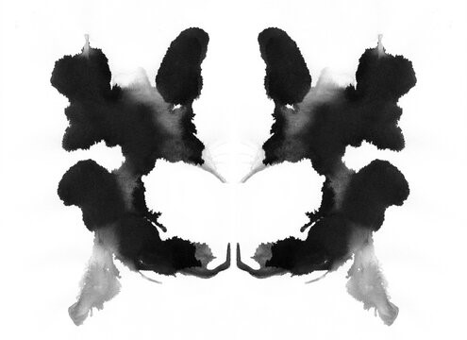

Slide 8
Notes:
What does that exersize show?
Some people stand-up
Life in this world can be hard...
Happy times too...
All these things can impact us.
When it comes to safety, a man named Paul O'Neill understood this. (read)
A culture..

Slide 9
What is the “Human Element”?
Notes:
Things to consider, the take away.

Slide 10
“The Human Element”
Why should I consider it?
Can accidents be eliminated?
What should I do when developing safety programs or guidelines?
Does it really matter?

Slide 11
Perfection
Notes:
What is it?
Can we achieve it?

Slide 12
5 Principles of Human Performance
Error is normal. Even the best people make mistakes.
Blame fixes nothing.
Learning and improving are vital. Learning is deliberate.
Context influences behavior. Systems drive outcomes.
How you respond to failure matters. How leaders act and respond counts.
Notes:
Book by Todd Conklin
When considering these principles, look at them with these 4 princables in mind.

Slide 13
4 Principles of Safety Differently
Safety is not defined by the absence of accidents, but by the presence of capacity.
Workers aren’t the problem, workers are the problem solvers.
We don’t constrain workers in order to create safety, we ask workers what they need to do work safely, reliably, and productively.
Safety doesn’t prevent bad things from happening, safety ensures good things happen while workers do work in complex and adaptive work environments.

Slide 14
Notes:
A Safety Culture is what…

Slide 15
“The Human Element”
Why should I consider it?
Can accidents be eliminated?
What should I do when developing safety programs or guidelines?
Does it really matter?

Slide 16
Chi Huynh SSH
VPP Coordinator
Valero Benicia Refinery
chi.huynh@Valero.com
707-742-0683
THE “HUMAN ELEMENT”
Notes:
Introductions.
What are we going to get out of this today?
The Rorchach Test. Developed in the early 20th century.

