Slide 1
Tank Terminal ISO Amendments
Michael Dossey
Supervising Accidental Release Prevention Engineer, Hazardous Materials Programs
December 5, 2024

Slide 2
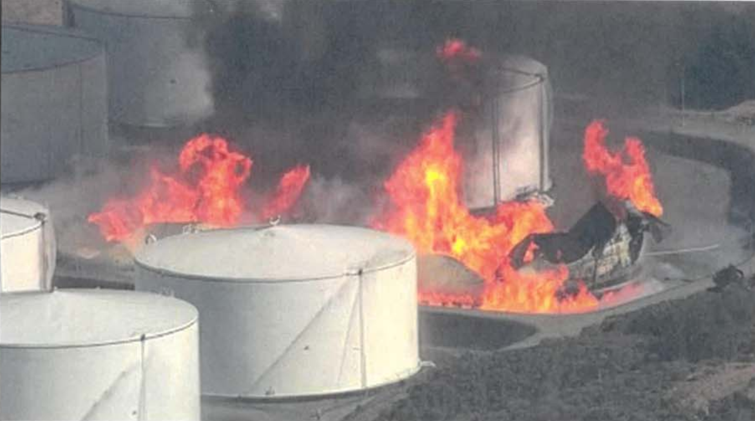
Nustar Incident
Notes:
Nustar ethanol tank incident 10/15/19

Slide 3
History
NuStar incident – October 2019
CCCFPD completed investigation – May 2021
Developed draft ordinance with stakeholders – February 2023
Reviewed draft ordinance with county counsel – June 2024
BOS approved ISO amendments – September 2024
City of Richmond approved RISO amendments – October 2024
Notes:
2019 Nustar incident – ISO Tank Terminal
2012 Chevron crude unit fire – CalARP Program 4 requirements
2005 BP Texas City – Safety culture added to ISO
1980/1990 incidents in county – ISO developed
Bhopal 1984 / Phillips Pasadena 1989 – Fed OSHA PSM and RMP

Slide 4
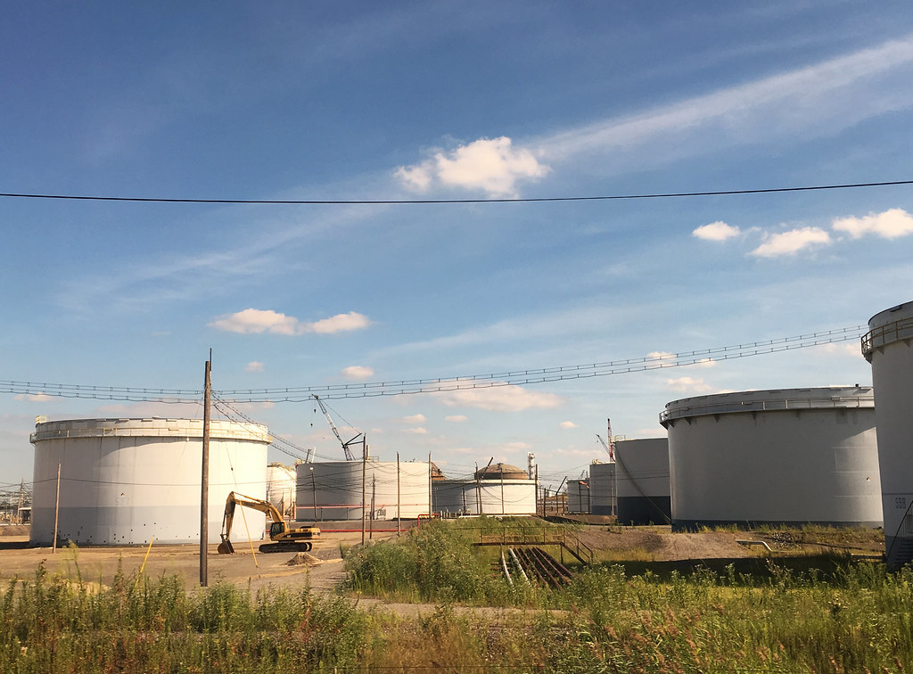
Applicability
Facility with at least one field erected tank of at least 50,000-gallon shell capacity and contains at least 10,000-pounds of a flammable liquid
8 facilities identified in initial review*
32 in Unincorporated County
1 in City of Martinez
4 in City of Richmond
*Contra Costa Health will continue to review facility submittals to determine any additional facilities potentially subject and will add to working group.

Slide 5
Flammable vs Combustible
"Flammable liquid" means a liquid having a closed cup flash point below 100° F (38° C).
"Combustible liquid" means a liquid having a closed cup flash point at or above 100° F (38° C).

Slide 6
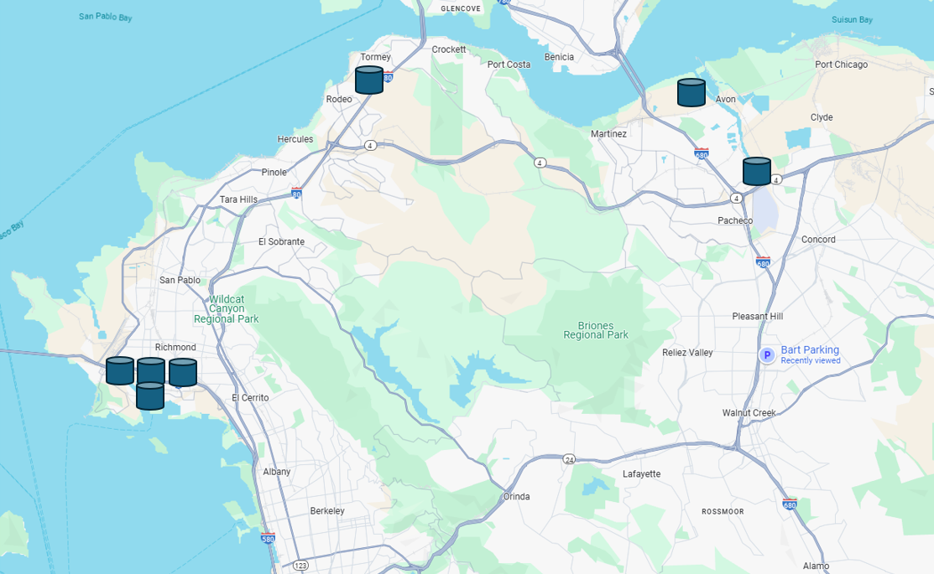
Proposed New Tank Terminal Facilities
Unincorporated County
Shore Terminals
Chevron Products-Avon
City of Martinez
TransMontaigne
City of Richmond
TransMontaigne
Kinder Morgan
IMTT
P66 Richmond Terminal
Notes:
4 within the City of Richmond
1 within the City of Martinez
2 within the unincorporated portions of Contra Costa County

Slide 7
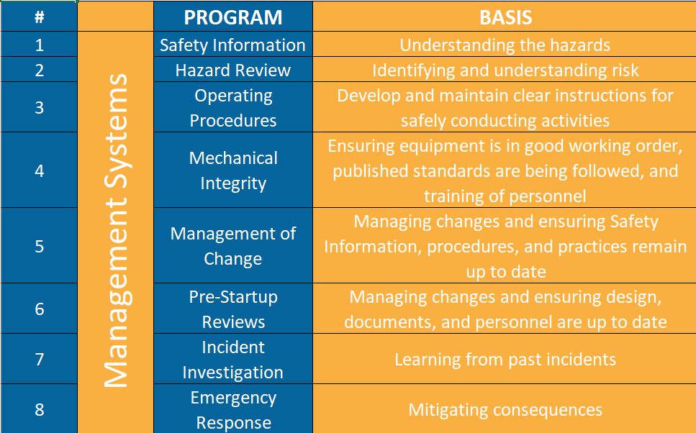
Safety Programs

Slide 8
ISO Stationary Source and Tank Terminal Regulatory Differences
SIMILAR
Process Safety Information
Operating Procedures
Training
Mechanical Integrity
Management of Change
Pre-Startup Reviews
Incident Investigations
Safe Work Practices
Emergency Response
Safety Program Management
Process Hazard Analysis
Security and Vulnerability Assessment
DIFFERENT
Employee Participation
Compliance Audits
Contractors
Human Factors Program
Management of Organizational Change
Safety Culture Assessments
Inherently Safer System Analysis
Safeguard Protection Analysis

Slide 9
Develop guidance document with stakeholders
Submittal of Safety Plans
Auditing

