Slide 1
Western States Petroleum Association
CAER Safety Summit No. 74
December 5, 2024

Slide 3
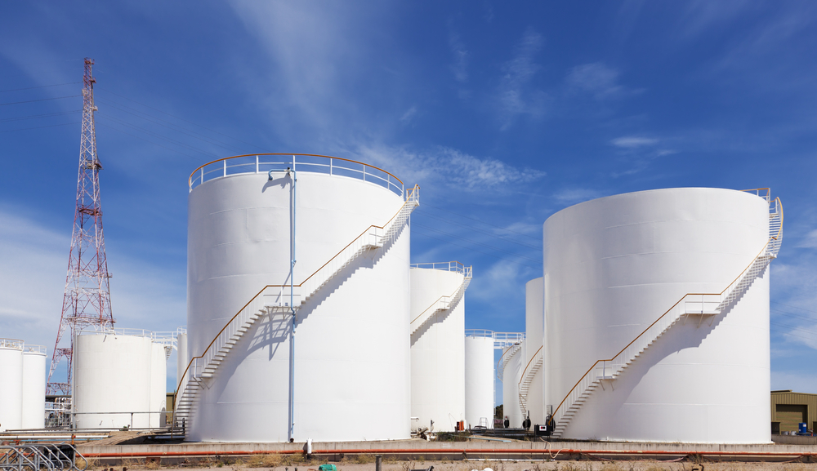
ASSEMBLY BILL X2-1 (Hart/Aguiar Curry)
Authorizes the California Energy Commission to impose requirements for refiners to maintain minimum levels of inventories of refined transportation fuels meeting California specifications, including any feedstocks and blending components.
Could artificially short the market of the fuel it needs.
Creates a pinch point in the refining process as a result of not having the ability to utilize storage capacity efficiently and effectively.
Requires refiners to submit a resupply plan or other arrangements sufficient to ensure that the loss of production during the turnaround or maintenance event does not adversely affect the California transportation fuels market. This requirement must be to the satisfaction of the CEC prior to commencing the turnaround or maintenance event.
Puts the CEC in a decision-making role in whether a refiner could conduct a turnaround or maintenance event that could put refinery workers and surrounding communities at risk.

